Slide 1






A new generation
of tech specialists

Slide 2
Early Detection
of Common Diseases
in Afghanistan
Using Machine Learning
Homa Akrami
Samiullah Gulzar

Slide 3
Outline
Concept note and implementation plan:​
Background​
Objectives​
SDG Relation​
Data​
Data Collection​
Exploratory Data Analysis (EDA) and Feature Engineering​
Model Selection and Training​
Model Evaluation and Hyperparameter Tuning​
Model Refinement and Testing​
Results​
Deployment​
Future Work

Slide 4
Background
Problem:
Afghanistan faces serious challenges in its healthcare system, including inadequate access to medical facilities, a shortage of specialists, and high rates of preventable diseases such as malnutrition, diarrhea, and respiratory infections . These issues are exacerbated in rural and underserved regions, where healthcare resources are scarce.
Proposed solution:
Develop a machine learning-based system for early detection of common diseases with the aim of improving access to health services and reducing mortality rates.

Slide 5
Objectives
Main objectives:
Develop a machine learning system to predict and diagnose common diseases.
Reduce mortality rates and improve treatment outcomes through early interventions.
Facilitate equitable access to health services in underserved and rural areas.
Provide actionable insights to policymakers to improve planning and resource allocation.

Slide 6
SDG Relation
Our project is primarily aligned with SDG 3: Good Health and Well-being, as it uses machine learning for early disease detection to improve public health outcomes and reduce mortality rates in underserved regions of Afghanistan. It also contributes to SDG 9: Industry, Innovation, and Infrastructure by leveraging innovative technology to strengthen healthcare infrastructure. Additionally, the project supports SDG 10: Reduced Inequality by targeting rural populations, reducing health disparities, and promoting equal access to healthcare services. Furthermore, the project indirectly supports SDG 11: Sustainable Cities and Communities by improving health in underserved areas, contributing to the development of healthier, more sustainable communities. While directly linked to SDG 3, the project also contributes to SDGs 9, 10, and 11.

Slide 7
Data

Slide 8
Data
The project will rely on the following data sources:
Afghanistan Demographic and Health Survey (DHS): Provides comprehensive health-related data.
World Health Organization (WHO) Datasets: Includes global and local health statistics.
OpenMRS: Offers patient-level clinical data. These datasets include essential attributes such as patient demographics, symptoms, diagnoses, and outcomes, forming a robust foundation for predictive modeling.

Slide 9
Data
Preprocessing Steps:
Data Collection: Data was sourced from Afghanistan Demographic and Health Survey (DHS), WHO, and OpenMRS.
Data Cleaning: Removing duplicate and inconsistent values to ensure data quality.
Encoding Categorical Variables: Converting text-based features into numerical values (e.g., using One-Hot Encoding for categorical variables).
Feature Scaling: Using StandardScaler to normalize numerical data and improve model performance.​

Slide 10
Data
Removing or replacing extreme values depending on their impact on the model​
Handling Missing Values and Outliers:
Imputation Methods:
For numerical variables: Mean or median imputation was applied.
For categorical variables: Mode imputation (most frequent value) was used.
Outlier Detection and Handling:
Identifying outliers using Z-score and Interquartile Range (IQR) methods.
Removing or replacing extreme values depending on their impact on the model​.

Slide 11
Model

Slide 12
Model Selection and Training/Testing
Details on Training the Model:
Selected Models:
Random Forest Classifier (Primary model due to high accuracy)
Logistic Regression (Used as a baseline for comparison)
Model Training Steps:
Preprocessed data, including extracted features from patient information, symptoms, and environmental data, was used as input.
Initial model configurations were set up for optimal performance tuning.
Models were trained and evaluated based on accuracy, recall, and F1-score.

Slide 13
Hyperparameters Used & Cross-Validation Techniques
Techniques for Hyperparameter Tuning:
Grid Search to find the best parameter values
Cross-Validation (K-Fold, k=5) to evaluate the model and prevent overfitting
Key Hyperparameters Tuned:
Random Forest:
n_estimators: Number of decision trees (increased to improve accuracy)
max_depth: Limits tree depth (to prevent overfitting)
min_samples_split: Minimum samples required to split a node
Logistic Regression:
C: Controls the regularization strength
solver: Different optimization algorithms for model training
These optimizations improved model accuracy and reduced overfitting.

Slide 14
Comparison of Models
Performance Comparison of Trained Models:
Analysis:
Random Forest had the best performance with 85% accuracy on test data.
Logistic Regression performed weaker due to its limitations.
With hyperparameter tuning and feature selection, Random Forest was the best choice for deployment.
Model | Accuracy | Precision | Recall | F1-Score
Random Forest | 85% | 0.87 | 0.82 | 0.84
Logistic Regression | 78% | 0.79 | 0.76 | 0.77

Slide 15
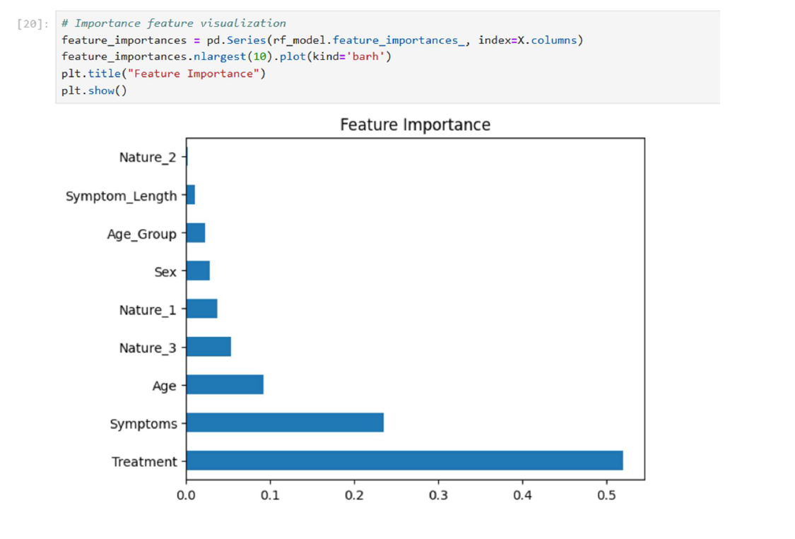
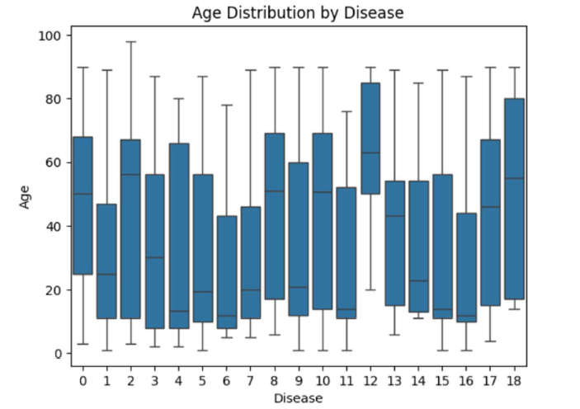
Visualization

Slide 16
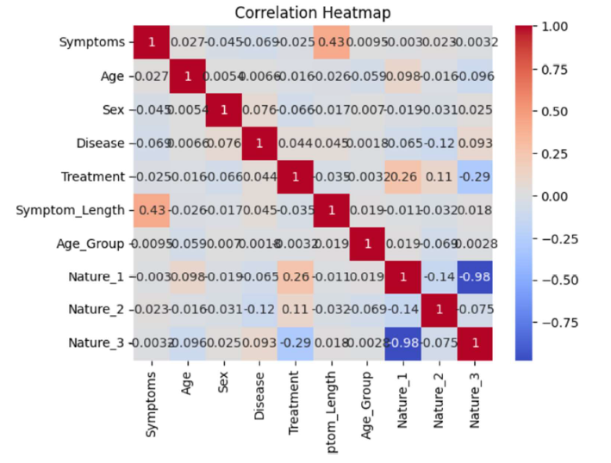
Visualization

Slide 17
Result

Slide 18
Evaluation Results
Showcase the results of your project here.

Slide 19
Deployment

Slide 20
Deployment
Deployment steps:
Serialize the model using the Joblib library.
Develop an API using Flask for real-time predictions.
Create a web UI using Streamlit.
Security considerations:
API key-based authentication.
Encrypt data using HTTPS.

Slide 21
Conclusion and Futurework
This project demonstrates the potential of machine learning in addressing healthcare challenges in low-resource settings. By using AI-driven diagnostics, the gap between technological advancements and healthcare needs can be bridged.
Model Improvement:
Expand dataset to improve accuracy
Build mobile app for real-time prediction
Add more disease detection capabilities (e.g. TB)
Improve surveillance with monitoring tools like Grafana & Prometheus
Explore more advanced algorithms like deep learning.
Project Expansion:
Integrate model with existing health systems in Afghanistan.
Provide training to health workers to use the system.

Slide 22


Thank you!

